Slide 1
IP and TB treatment access issues
Sergey Golovin, IP and access consultant with ITPC EECA

Slide 2
New approach to END TB
The Global Plan to End TB 2023 – 2030
TB treatment access goals:
Deliver treatment to 50 million people from 2023 to 2030, including 4.7 million children and 3.32 million people with rifampicin-resistant (RR-) or multidrug-resistant (MDR-) TB.
Initiate appropriate treatment for all people diagnosed with TB.
Achieve at least 90% treatment success for all forms of TB.
1/4/6 х 24 Strategy
1 = One-month and once-weekly TB preventive treatments, 1HP and 3HP (one month of daily, or three months of weekly isoniazid and rifapentine).
4 = Four-month treatment regimens for drug-sensitive TB, 4HPMZ for adults and adolescents (four months of isoniazid, rifapentine, and moxifloxacin with pyrazinamide for the first two months) and 4HRZ[E] for children with non-severe TB (four months of isoniazid, rifampicin with pyrazinamide, and in certain circumstances with ethambutol, for the first two months).
6 = Six-month treatment regimens for drug-resistant TB, 6BPaL[M] (six months of bedaquiline, pretomanid, linezolid, with moxifloxacin depending on drug-susceptibility).
x 24 = by the end of 2024!

Slide 3
Treatment access – an essential component to END TB!

Slide 4
Key barriers to treatment access
Drug lists (procurement, essential medicines lists., treatment guidelines etc.
Budget constraints
Price barrier (aka high price)
Logistics issues
Planning issues
Lack of information

Slide 5
Price barrier: often caused by monopolies
!
Causes of monopolies:
- Patents
- Preferences
- Collusion
a licence conferring a right or title for a set period, especially the sole right to exclude others from making, using, or selling an invention.

Slide 6
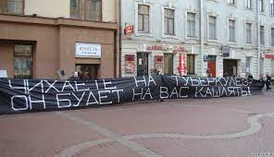
Treatment access activism: how it starts

Slide 7
Activism and treatment access: from stock-outs to patents
 Messages about treatment stock-outs
☹ Drug procurement analysis (prices, volumes etc.), treatment guidelines, drug lists
☹Patent status, licensing agreements analyses
Patent oppositions, compulsory license campaigning

Slide 8
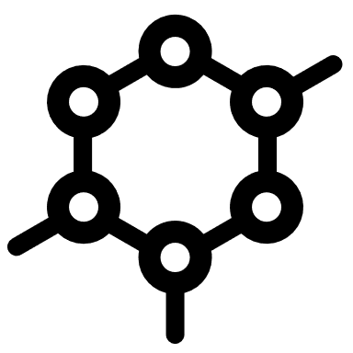
Price is an essential access component!
Patent (circle) = minimum 20-year monopoly
Generics
API patent
Salts, crystal forms etc.
Process patents
Original
There are other patents, like methods of treatment (e. g. BPaL), formulations etc.

Slide 9
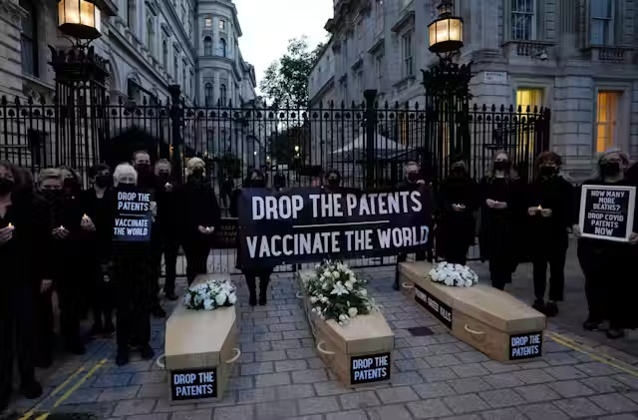
What can activists do with IP to improve access?
Follows the relevant news
Support international, regional, national campaigns
Send requests to pharmaceutical companies, UN agencies and other international organizations.
Analyze the connection between patents and limited access, and publish reports
Run own campaigns (Drop the Patent, compulsory licensing campaigns* etc.)
Oppose patents
* Compulsory license –when a government or a court allows someone else to produce a patented product or process without the consent of the patent owner, often in the interests of public health

Slide 10
TB Drugs
Bedaquilines (part of BPaL)
Pretomanid (part of BPaL)
Delamanid
Sutezolid (in development)
Linezolid (off-patent)

Slide 12
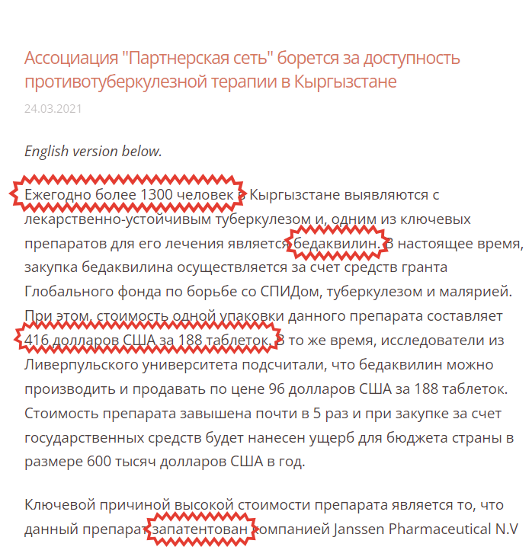
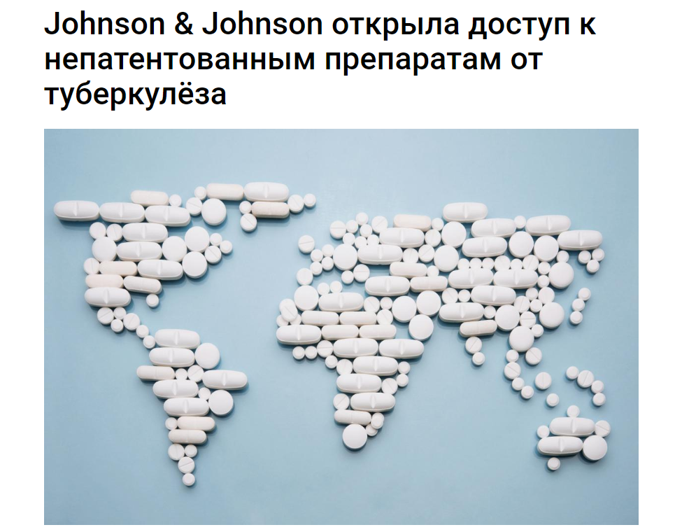

Slide 13
Questions and discussion

